Slide 1

Green Pace
Security Policy Presentation
Developer: Bret Thex

Slide 2

OVERVIEW: DEFENSE IN DEPTH
This Security contains policies, standards, principles, and best practices that help prevent the threat of potential security vulnerabilities in both code development and systems architecture.

Slide 3
THREATS MATRIX
The highest priority threats should be handle ASAP.
The lowest priority issues should not be forgotten.
Likely STD-003-CPP STD-005-CPP STD-010-CPP | Priority STD-003-CPP - P18 STD-005-CPP - P18 STD-010-CPP - P18 STD-002-CPP - P6
Low priority STD-001-CPP - P3 STD-006-CPP - P1 STD-008-CPP - P1 | Unlikely STD-001-CPP STD-006-CPP STD-008-CPP

Slide 4
10 PRINCIPLES
Validate Input Data
STD-004-CPP
Heed Compiler Warnings
STD-001-CPP
STD-002-CPP
Architect and Design for Security Policies
STD-003-CPP
STD-005-CPP
STD-007-CPP
STD-008-CPP
STD-009-CPP
Keep It Simple
STD-002-CPP
STD-010-CPP
Default Deny
STD-004-CPP
Principle of Least Privilege
STD-004-CPP
STD-008-CPP
Sanitize Data Sent to Other Systems
STD-004-CPP
STD-008-CPP
Defense in Depth
STD-004-CPP
Effective Quality Assurance Techniques
STD-002-CPP
STD-006-CPP
Adopt a Secure Coding Standard
STD-003-CPP
STD-004-CPP
STD-007-CPP

Slide 5
CODING STANDARDS
STD-003-CPP: String Correctness - Do not attempt to create a std::string from a null pointer
STD-005-CPP: Memory Protection - Do not access freed memory
STD-010-CPP: Containers - Do not use an additive operator on an iterator if the result would overflow
STD-004-CPP: SQL Injection - Verify input data
STD-002-CPP: Data Value - Ensure that integer conversions do not result in lost or misinterpreted data
STD-007-CPP: Exceptions - Handle all exceptions
STD-009-CPP: Error Handling - Do not abruptly terminate program
STD-001-CPP: Data Type - Never qualify a reference type with const or volatile
STD-006-CPP: Assertions - Incorporate diagnostic tests using assertions
STD-008-CPP: Bit-fields - Avoid information leakage when passing a class object across a trust boundary
*Ranked by severity and likelihood

Slide 6
ENCRYPTION POLICIES
Encryption at rest - Ensures that long term data is stored in a secure location and encrypted
Encryption at flight - Ensures that the proper encryption techniques are used to keep data safe while moving from one location to another
Encryption in use - Ensures that sensitive data is encrypted as well as the connection that is being to access data is secure.

Slide 7
TRIPLE-A POLICIES
Authentication - Determining if the user exists
Multi Factor Authentication
Authorization - What does the user have access to
Using access level on user by user basis
Accounting - Logs of what is happening
Changes to the Database
Files access by users
Addition of new users

Slide 8
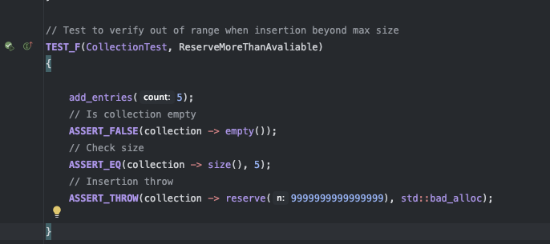
Unit Testing
ReserveMoreThanAvaliable

Slide 9
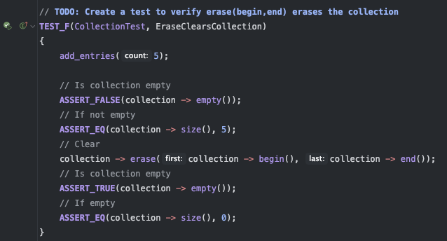
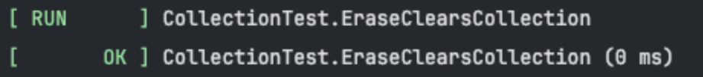
Unit Testing
EraseClearsCollection

Slide 10
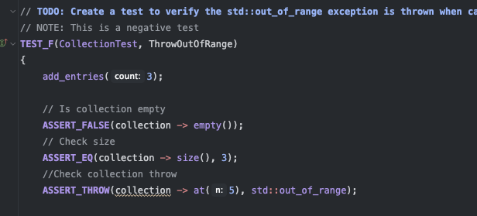

Unit Testing
ThrowOutOfRange

Slide 11
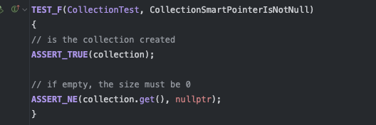
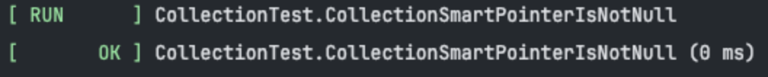
Unit Testing
CollectionSmartPointerIsNotNull

Slide 12

AUTOMATION SUMMARY

Slide 13
TOOLS
A DevSecOps Pipeline is a DevOps with integrated security throughout all steps
Automation Tools
Cppcheck - used during design stage for coding errors
https://cppcheck.sourceforge.io/
Clang - Used during design stage for coding errors
https://clang.org/
Parasoft C/C++ test - used during design, verify/test, and transition stages
https://www.parasoft.com/
Papertrail - log management and analysis
https://www.papertrail.com/

Slide 14
RISKS AND BENEFITS
PROS:
Preventative
Early implementation is more effective
Less vulnerabilities
Stronger Security
CONS:
Time to implement all aspects
Upfront Cost to implement
More complex to manage
Need more expertise to implement fully

Slide 15
RECOMMENDATIONS
Policy should be reviewed on a yearly basis to check for weak points and updated accordingly
Security checks should be conducted by a third party security firm
Response to security flaws in post production phase should be outlined

Slide 16
CONCLUSIONS
Security Matters
Validate Input Data
Heed Compiler Warnings
Design for Security
Keep It Simple
Default Deny
Principle of Least Privilege
Sanitize Data sent to Other Systems
Practice Defense in Depth
Use Effective Quality Control Techniques
Adopt a Secure Coding Standard

Slide 17
REFERENCES
Carnegie Mellon University. (2024, 2). Confluence. Confluence Mobile - Confluence. Retrieved October 20, 2024, from https://wiki.sei.cmu.edu/confluence/pages/viewpage.action?pageId=88046682
NIST. (2020, 10). Security Guidelines for Storage Infrastructure. NIST Technical Series Publications. Retrieved October 20, 2024, from https://nvlpubs.nist.gov/nistpubs/SpecialPublications/NIST.SP.800-209.pdf

